Slide 1
Organic Agriculture Worldwide 2023: Infographics
Jan Trávníček, Bernhard Schlatter and Helga Willer
© FiBL, February 2025

Slide 2
GLOBAL DATA

Slide 3
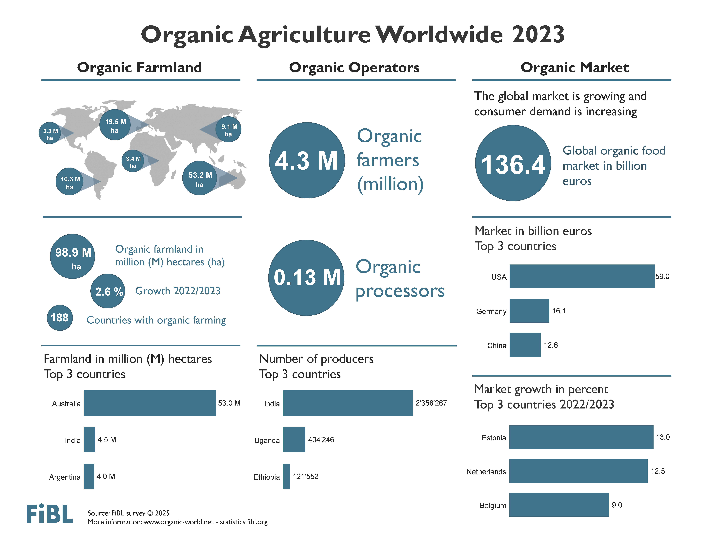

Slide 5
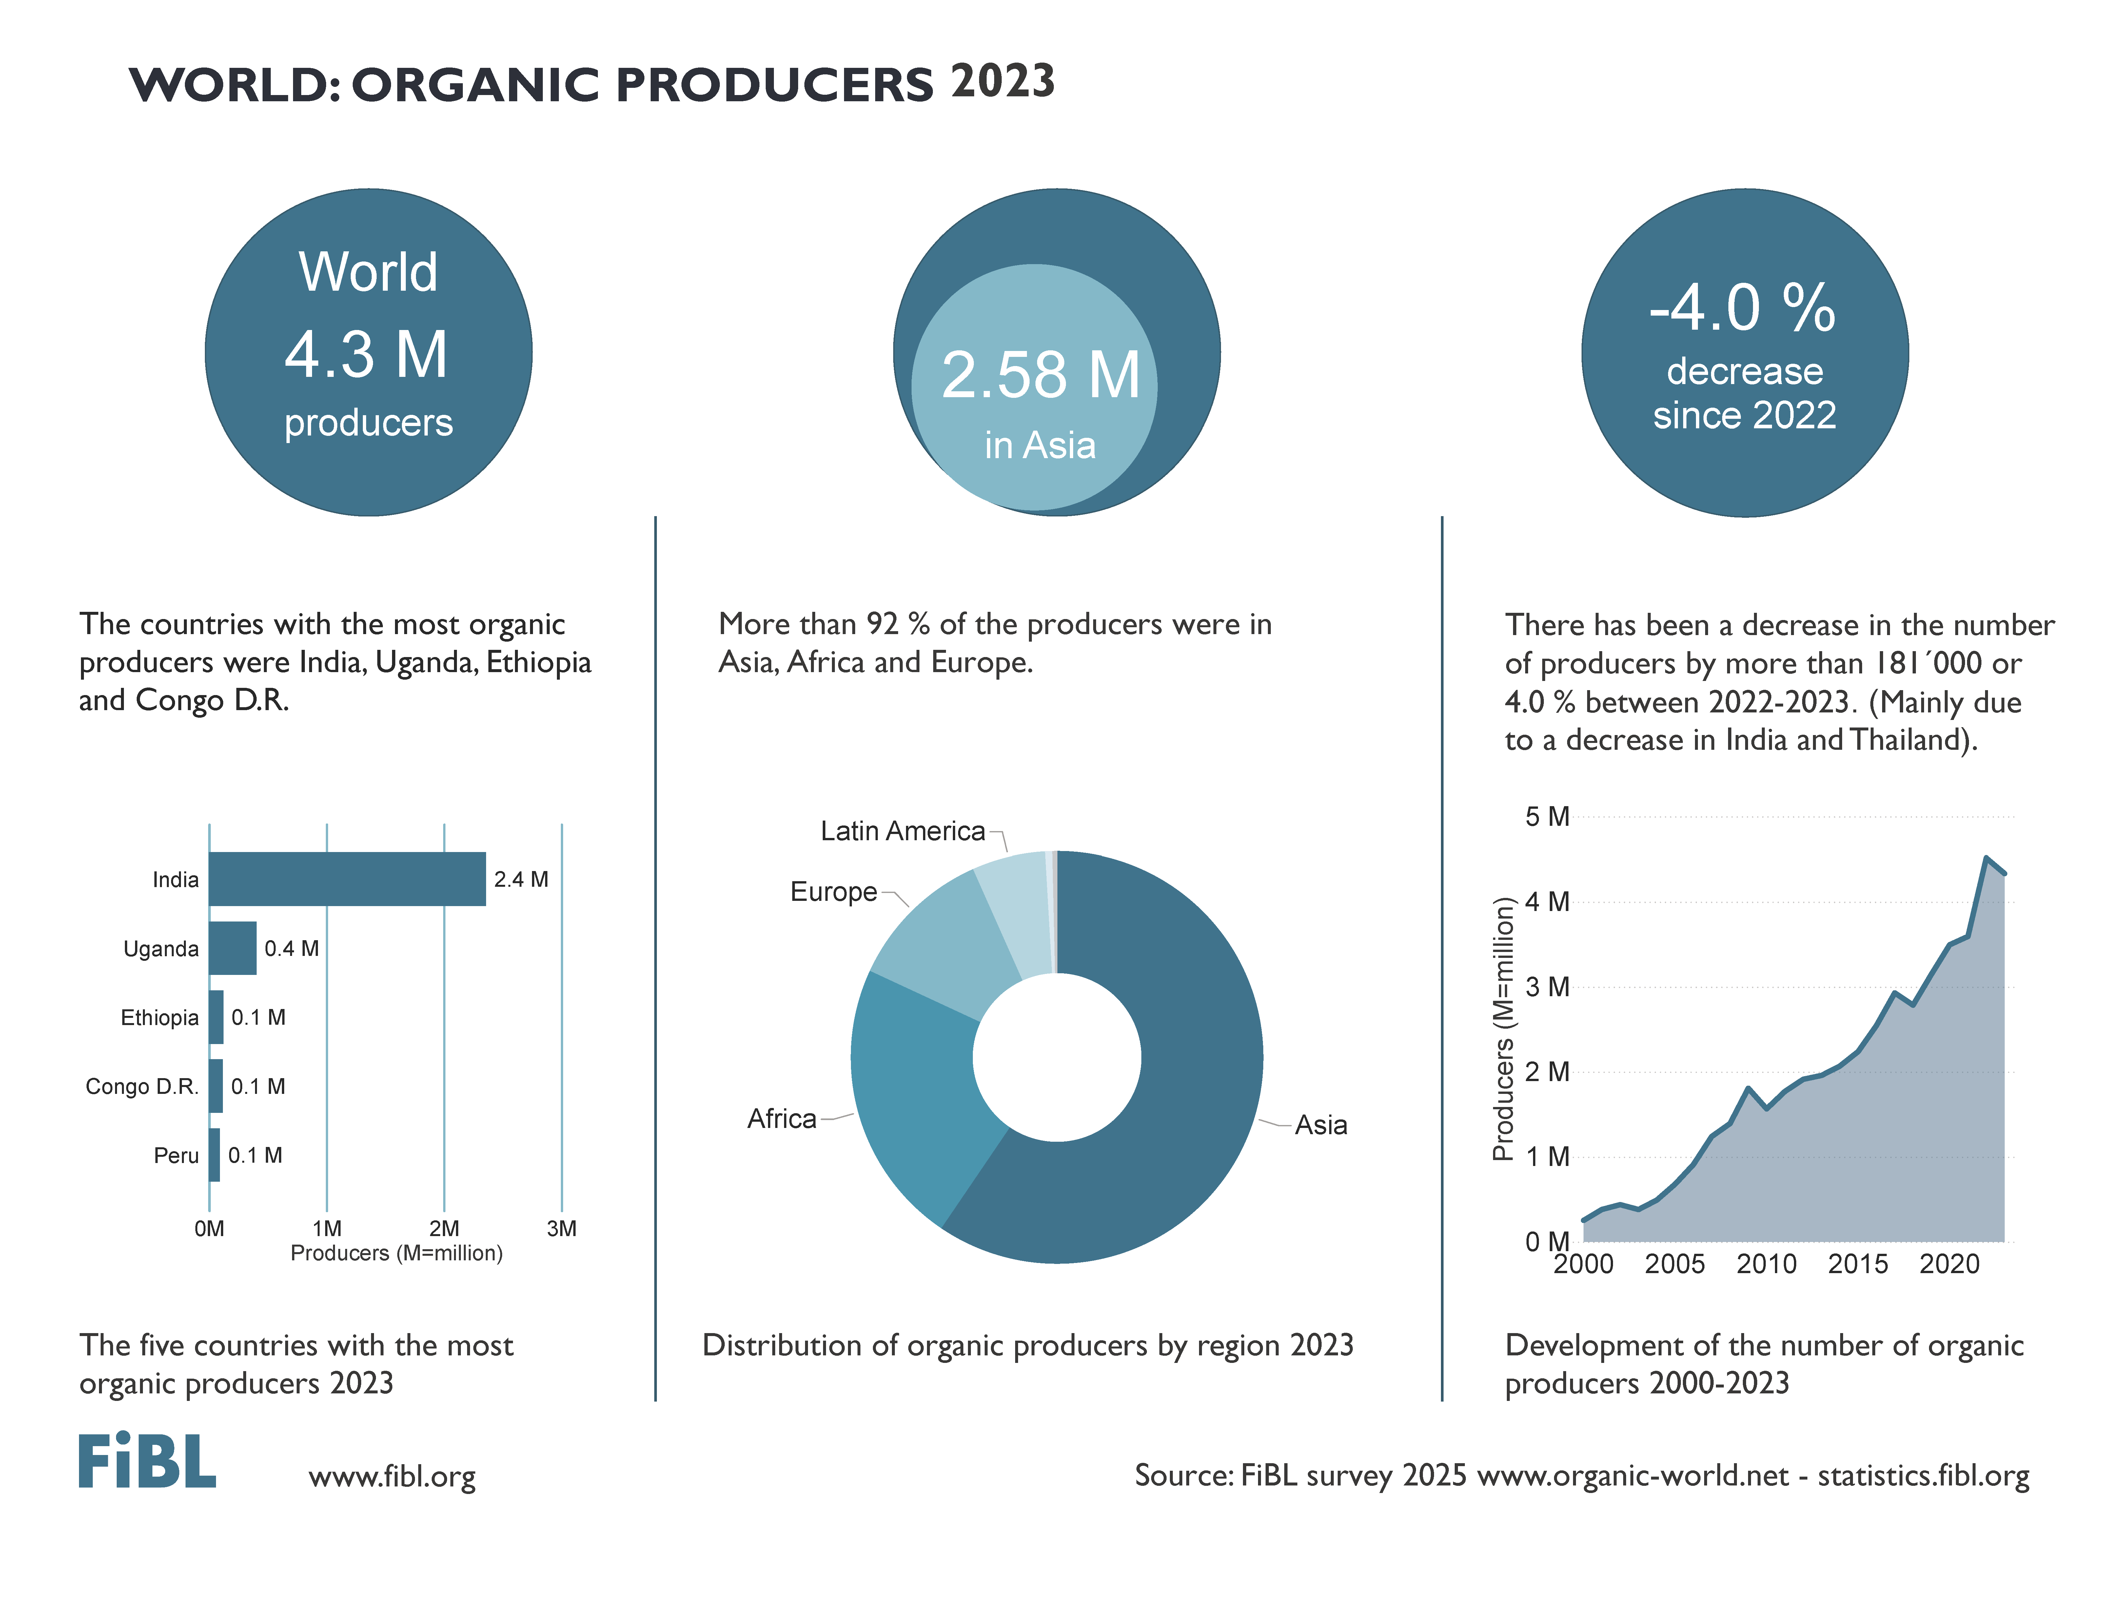

Slide 6
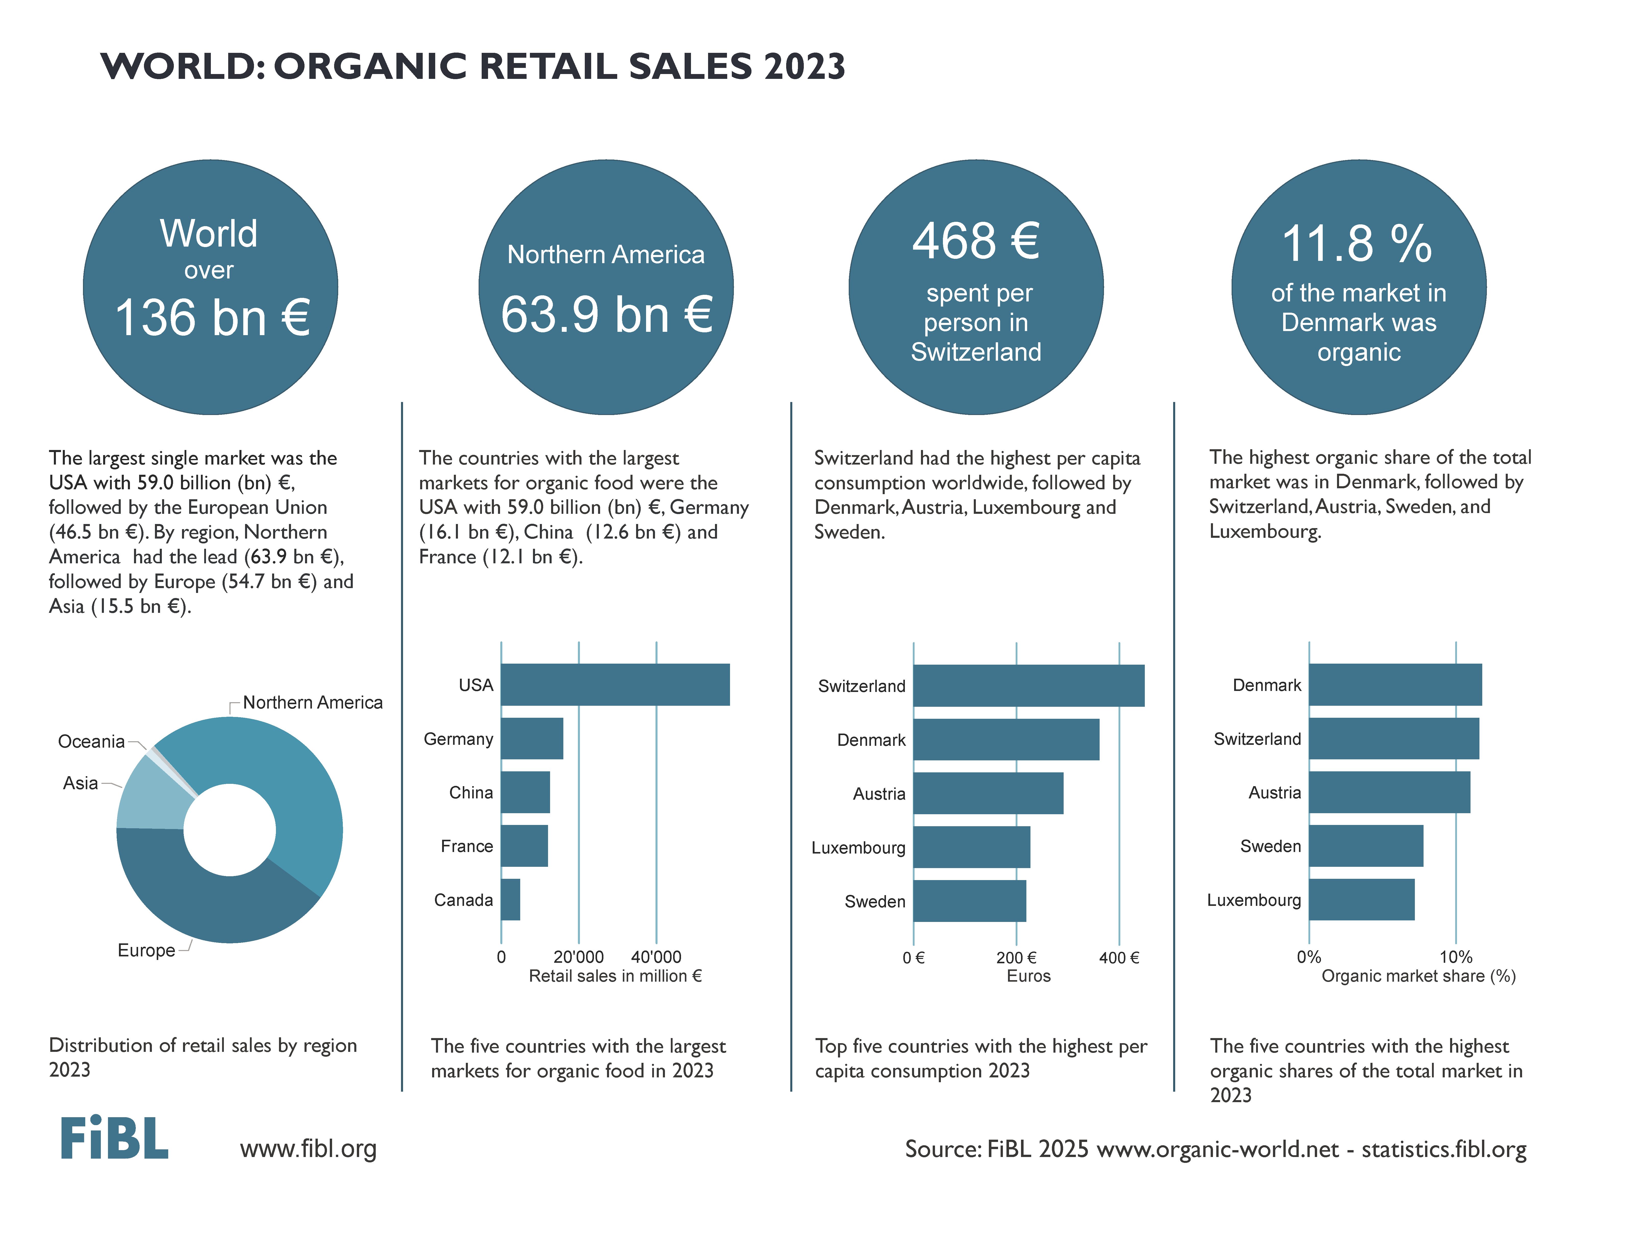

Slide 7
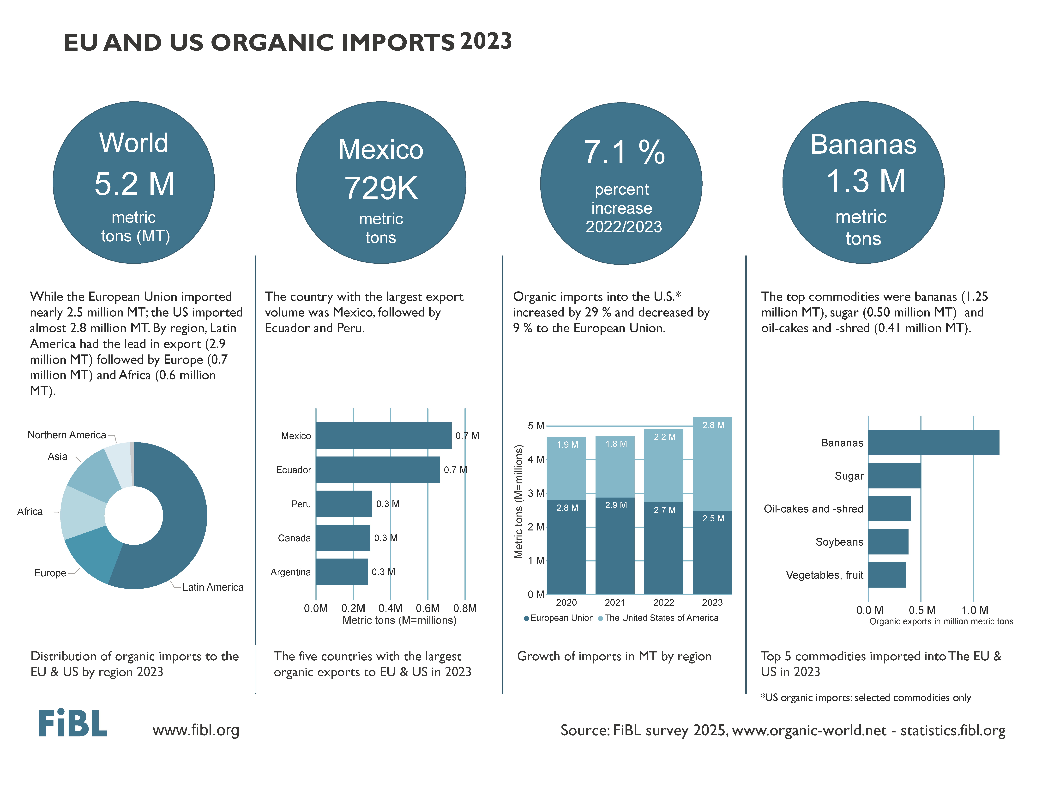

Slide 8
EUROPE

Slide 10
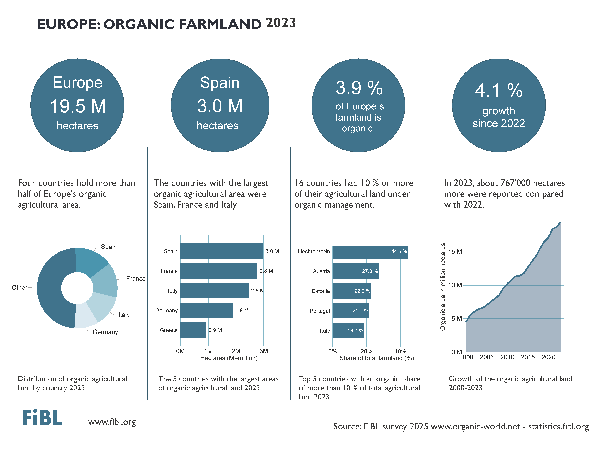

Slide 11
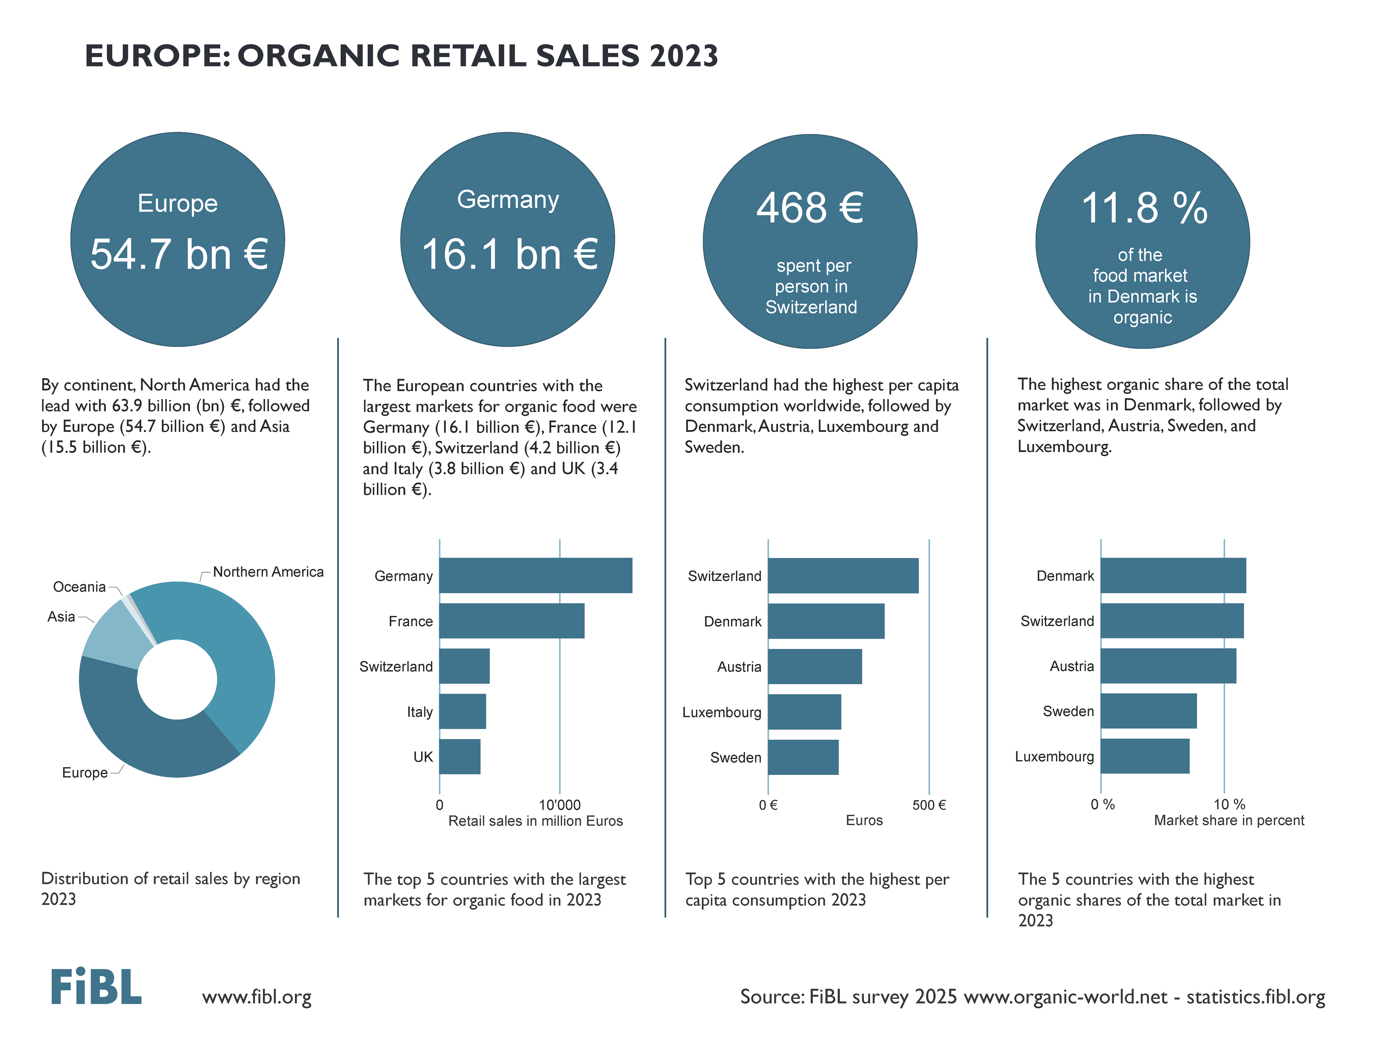

Slide 12
EUROPEAN UNION

Slide 14
BACKGROUND

Slide 15
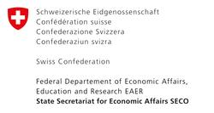
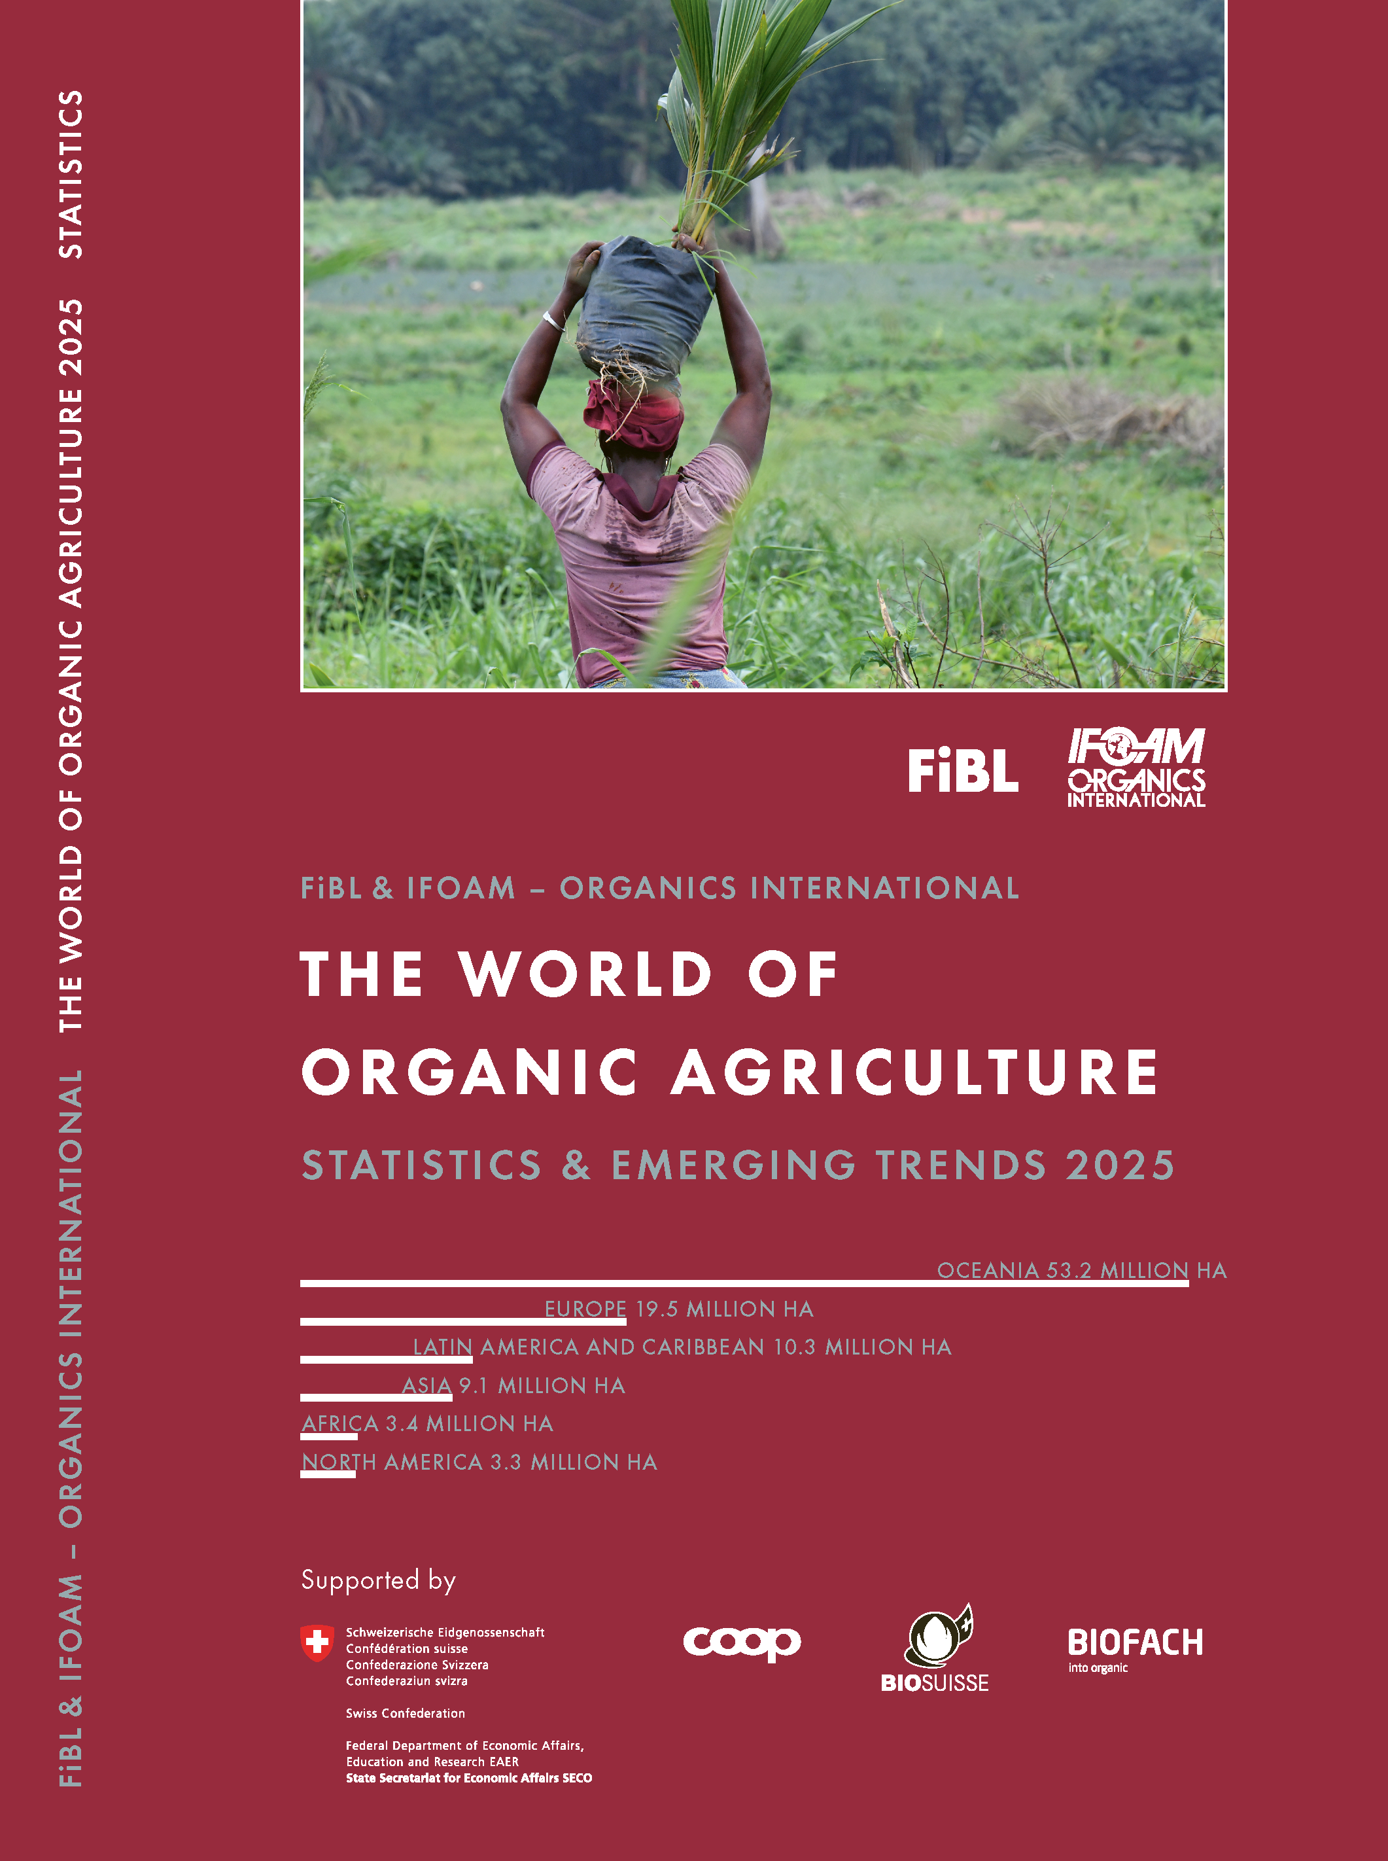
The World of Organic Agriculture 2025
The 26th edition
Data tables
Country and continent reports
Markets, standards, policy support
The book can be ordered or downloaded at https://www.fibl.org/en/shop-en
www.organic-world.net
https://statistics.fibl.org
More than 200 experts from all parts of the world contributed to the survey 2025.

Slide 16
Organic Agriculture Worldwide: Key results from the FiBL survey on organic agriculture worldwide 2025
Data compiled by the Research Institute of Organic Agriculture (FiBL), Frick, Switzerland, based on national data sources and data from certifiers.
For updates, check www.organic-world.net
This presentation is available online at: https://www.organic-world.net/yearbook/yearbook-2025/presentations.html
Texts and graphs: Helga Willer, Bernhard Schlatter, Jan Trávníček, Research Institute of Organic Agriculture (FiBL), Frick, Switzerland
Contact: Helga Willer, helga.willer@fibl.org, Research Institute of Organic Agriculture (FiBL), Frick, Switzerland
© Research Institute of Organic Agriculture (FiBL), Frick, Switzerland, February 2025
Citation: Willer, Helga, Bernhard Schlatter and Jan Trávníček (Eds.) (2025): The World of Organic Agriculture. Statistics and Emerging Trends 2025. Research Institute of Organic Agriculture FiBL, Frick, and IFOAM – Organics International, Bonn.
Notes:
FiBL
10.02.2025
www.fibl.org
16

Slide 17
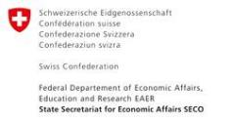
Acknowledgements
Swiss State Secretariat of Economic Affairs (SECO)
Coop Sustainability Fund
Bio Suisse
NürnbergMesse, the organizers of BIOFACH
IFOAM – Organics International
More than 200 experts from all parts of the world contributed to the FiBL survey 2024.

Slide 18
The 26th survey on organic agriculture world-wide
The 26th survey on organic agriculture worldwide was carried out by the Research Institute of Organic Agriculture FiBL in cooperation with partners from all around the world. The results were published jointly by FiBL and IFOAM – Organics International.
The survey was carried out between July 2024 and February 2025.
Data were received from 188 countries.
Data was provided by over 200 country experts (representatives from NGOs, certification bodies, governments, researchers).
The following data was collected: area data (including land use and crop details); producers, other operator types; domestic market values; export and import data; livestock data (animal heads and production in metric tons).
The results are published in the yearbook “The World of Organic Agriculture 2025” and on www.organic-world.net.

Slide 19
Disclaimer
All of the results contained in this slide show have been compiled by the Research Institute of Organic Agriculture (FiBL). However, the possibility of mistakes cannot be ruled out entirely. Therefore, FiBL is not subject to any obligation and makes no guarantees whatsoever regarding any of the statements or results in this work; neither does FiBL accept responsibility or liability for any possible mistakes, nor for any consequences of actions taken by readers based on statements or advice contained therein.
This document has been produced with the support of the Swiss State Secretariat for Economic Affairs (SECO), the Sustainability Fund of Coop Switzerland, Bio Suisse, NürnbergMesse, IFOAM – Organics International. The views expressed herein can in no way be taken to reflect the official opinions of SECO, Coop, Bio Suisse NürnbergMesse or IFOAM – Organics International.

Slide 20
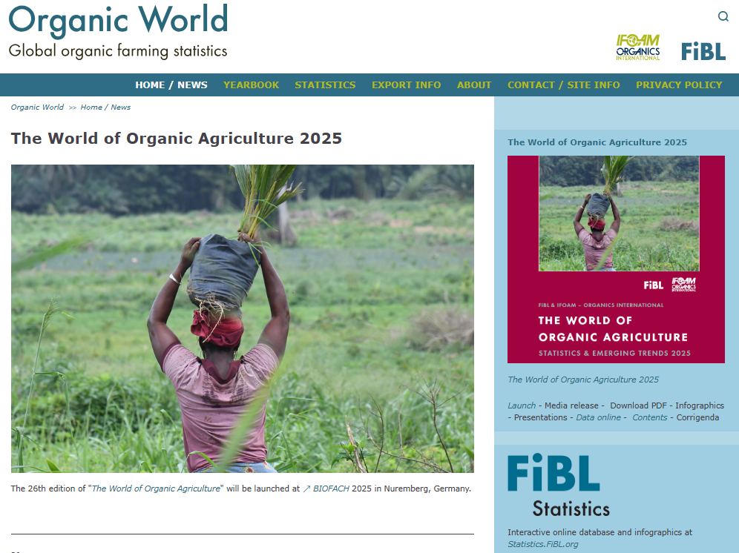
Presentations on www.organic-world.net

Slide 21
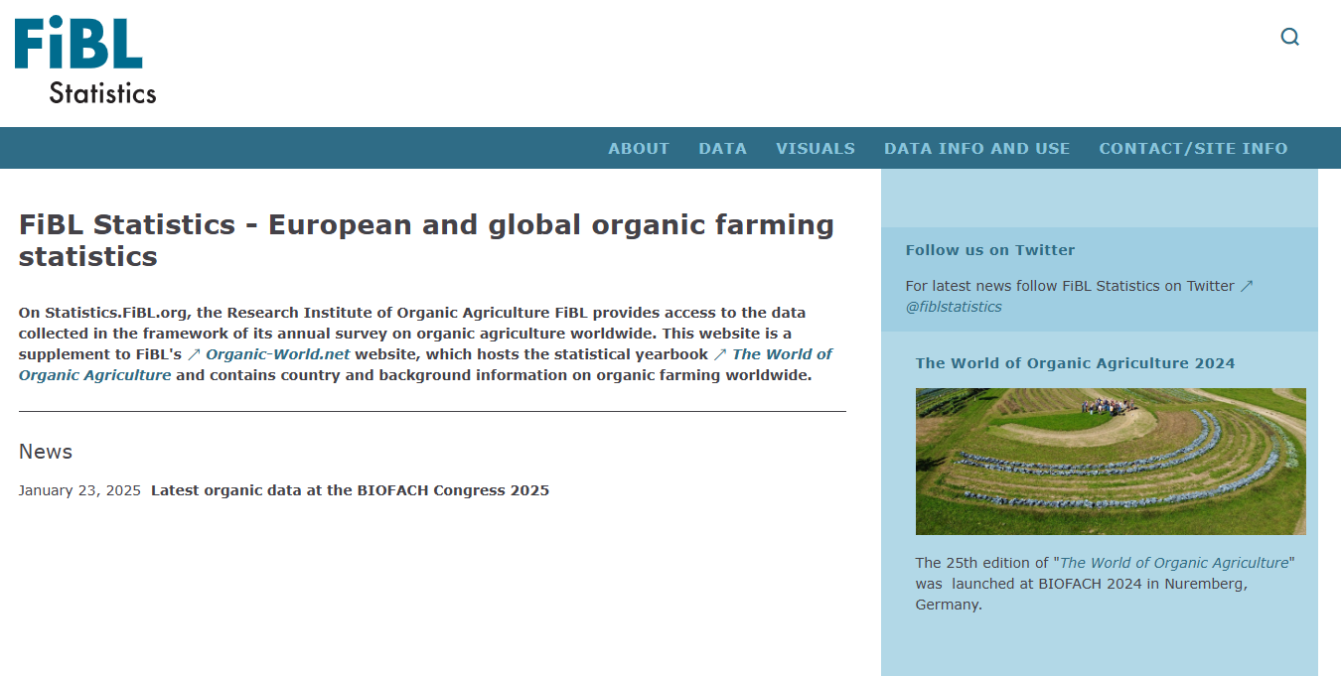
Statistics.FiBL.org

Slide 22
Contact
Helga Willer Research Institute of Organic Agriculture FiBL Ackerstrasse 113, Box 219 5070 Frick Switzerland
Phone +41 62 865 72 72 Phone +41 62 865 72 07 (direct)
info.suisse@fibl.org, helga.willer@fibl.org www.fibl.org, www.organic-world.net, https://statistics.fibl.org

Slide 23
FiBL online
www.fibl.org
www.bioaktuell.ch
fiblfilm
@fiblorg
@FiBLaktuell
linkedin.com/company/fibl

